Slide 1




STOCK MARKET PRICE PREDICTION

Slide 2

Introduction
Implementation
Conclusion
Future Scope
CONTENT

Slide 3

INTRODUCTION
In the realm of finance, particularly in stock market trading, the ability to accurately predict stock prices is of paramount importance. This project endeavors to explore machine learning techniques to predict stock market prices, focusing on companies like Google (GOOG), Apple (AAPL), and Amazon (AMZN). The project's significance lies in its potential to offer insights into future stock trends, aiding investors, financial analysts, and traders in making informed decisions.

Slide 4

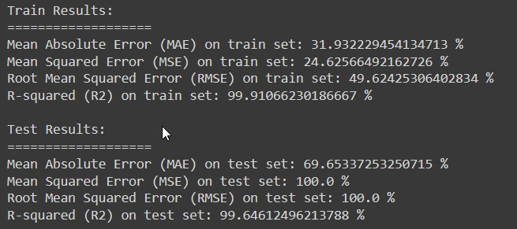


IMPLEMENTATION

Slide 5
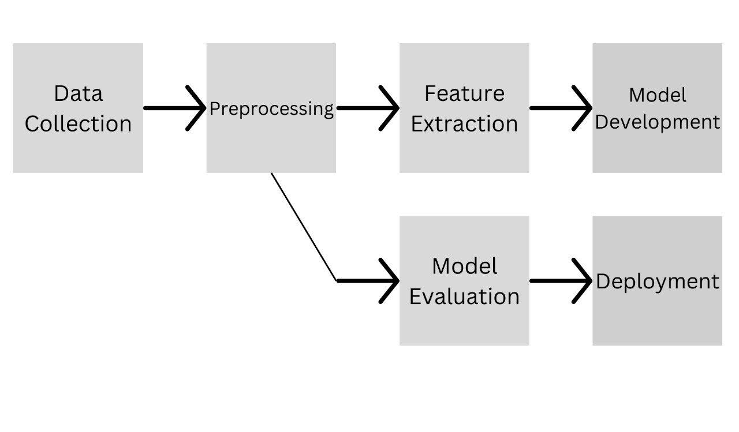
IMPLEMENTATION

Slide 6
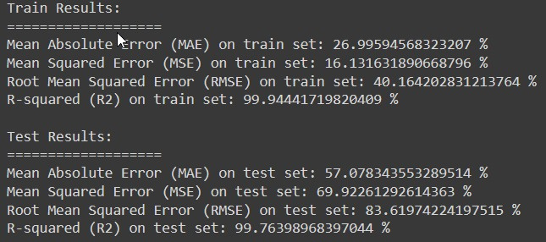
IMPLEMENTATION

Slide 7
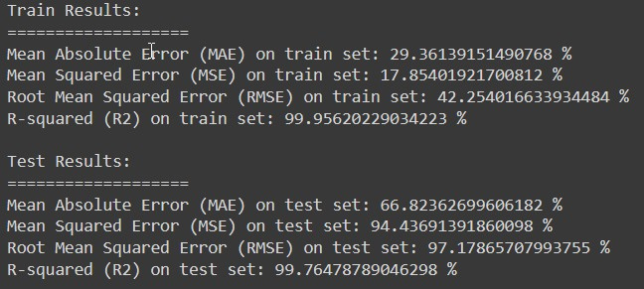
IMPLEMENTATION

Slide 8


CONCLUSION
In this project, we utilized machine learning to predict stock market prices for Google, Apple, and Amazon using historical data. We collected and preprocessed the data, including open, high, low, close prices, adjusted close prices, and trading volume. Exploratory data analysis revealed correlations between stock returns and closing prices, providing valuable insights into market trends. We then employed Random Forest Regressors to predict closing prices, achieving promising results with high R-squared scores on both training and testing datasets.

Slide 9
Future areas for exploration and improvement include:
Feature Engineering
Model Tuning
Ensemble Methods
Time-Series Analysis
Real-Time Prediction
Risk Management
FUTURE
SCOPE

Slide 10

THANK YOU
TEAM MEMBERS
Sanu Verma :- 21051509
Tanvi Ananya Kappala :- 21051523
Utkrist Jaiswal :- 21051526

